Slide 1
Secure Data Hiding In Images Using Steganography
CAPSTONE PROJECT
Presented By: Anjali Patel
Student Name : Anjali Patel
College Name & Department : Ganpat University / Computer Science

Slide 2
OUTLINE
Problem Statement
Technology used
Wow factor
End users
Result
Conclusion
Git-hub Link
Future scope

Slide 3
Problem Statement
In the modern digital landscape, protecting data and privacy is crucial. Traditional encryption methods can be vulnerable to detection and interception. This project solves this problem by using steganography, which conceals secret messages within images. This technique provides a discreet way to communicate, enhancing data security while remaining unnoticed.

Slide 4
Technology used
Programming Language: Python
Libraries:
Pillow (PIL) Library
Cryptography
Platform: Windows
IDE : IDLE(comes with Python)

Slide 5
Wow factors
Secure Encryption: Utilizes the robust Fernet symmetric encryption to securely encrypt messages before embedding them in images, ensuring confidentiality.
Custom Key Generation: Generates a unique encryption key from a user-defined password, allowing for personalized security tailored to individual users.
Seamless Image Integration: Embeds encrypted messages directly into the alpha channel of PNG images, maintaining the visual integrity of the original image while hiding sensitive information.
User -Friendly Interaction: Provides a simple command-line interface for users to easily input messages and passwords, making the process accessible even for those with minimal technical knowledge.
Dual Functionality: Supports both encoding and decoding of messages, allowing users to hide and later retrieve information from images with ease.
Error Handling: Includes exception handling during the decoding process to gracefully manage incorrect passwords or other issues, enhancing user experience and reliability.

Slide 6
End users
Security professionals and cybersecurity enthusiasts.
Journalists, activists, and government agencies needing secure communication channels.
Students and researchers interested in data privacy and steganography.
General users looking for enhanced digital security.

Slide 7
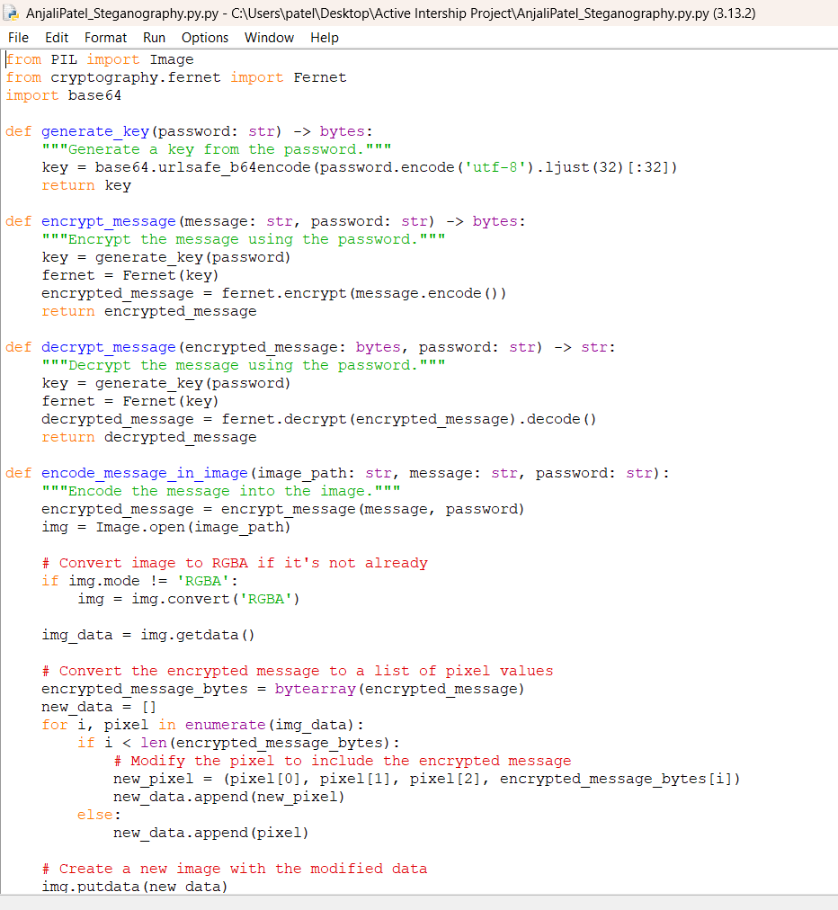
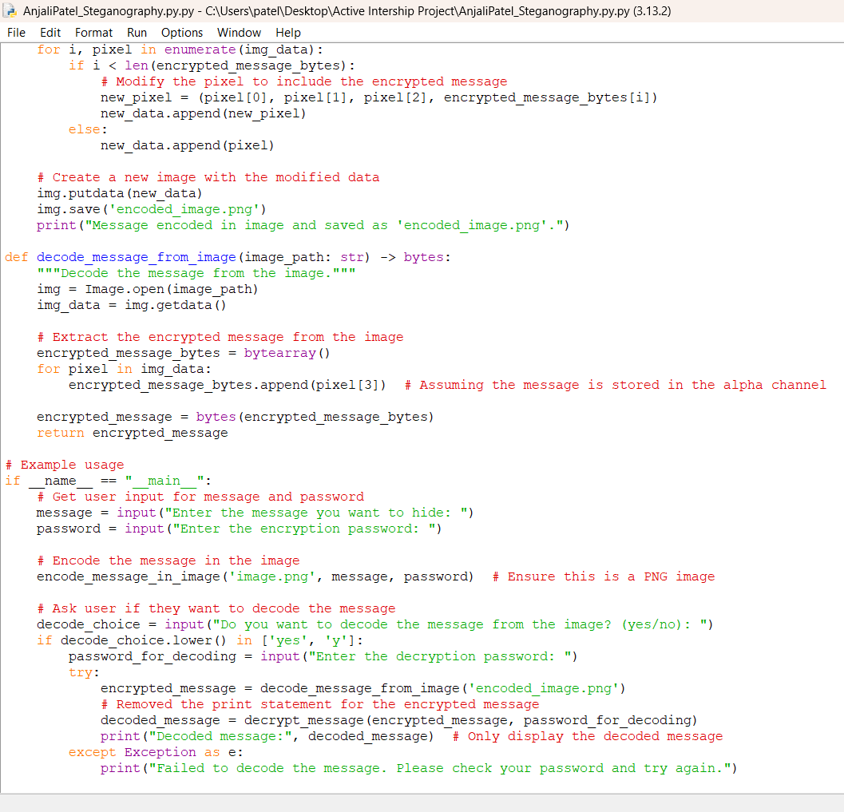
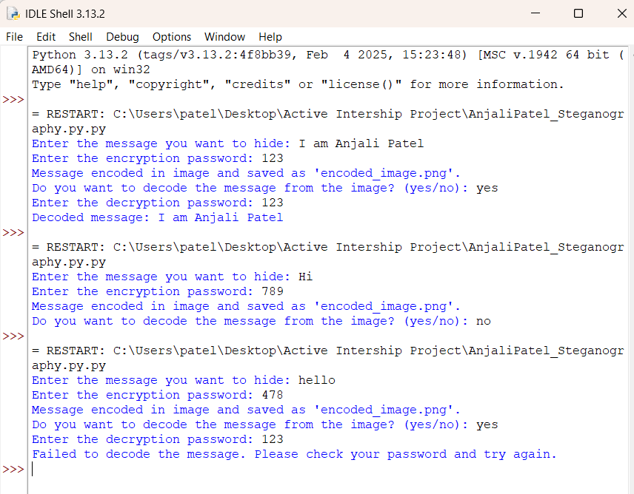
Results

Slide 8
Conclusion
This project showcases a new method for data security by concealing information within an image using LSB steganography.
This technique is both secure and hard to detect, as it embeds important header details like passcodes and message lengths.
The user-friendly interface makes the method easy to use, turning it into a practical tool for safe communication.
This project adds value to the larger field of digital privacy and secure data transmission.

Slide 9
GitHub Link
https://github.com/AnjaliRahulBhaiPatel/ANRP1725

Slide 10
Future scope(optional)
Support for various image formats: Allow the method to work with different image types and higher resolution images.
Expand to video steganography: Adapt the technique for hiding data in videos, enabling dynamic data concealment.
Integrate advanced encryption methods: Use more sophisticated encryption algorithms to enhance the security of the hidden messages.
Create a web or mobile application: Develop an app to make the tool more accessible to a wider audience.
Investigate automated detection and extraction tools: Explore tools that can automatically detect and extract hidden content from steganographic files.

Slide 11
THANK YOU

